Slide 1
DATA BASE PROJECT
Blood Bank Management System
Group Members :
Kantesh Kumar
ID :BSE-23F-250
M.Sami Malik
ID:BSE-23F-251
Abdulla Arfaq
ID:BSE-23F-096

Slide 2
INTRODUCTION
Blood Bank Management System (BBMS) is a browser-based system that is designed to store, process, retrieve and analyze information concerned with the administrative and inventory management within a blood bank.

Slide 3
System Features
List the key features of the Blood Bank Management System, such as:
Donor Management (registration, medical history tracking)
Recipient Management (tracking blood needs, medical history)
Blood Inventory Management (stock levels, expiry dates)
Donation Recording (quantity, blood type, test results)
Blood Transfusion Management (tracking blood usage)
Reporting and Analytics (blood availability, trends, etc.)pen_spark

Slide 4
TABLES: Blood Bank Management System has 10 total tables, Each storing valuable information on an Blood Bank. Tables are as follows:
Donors: Stores information about blood donors.
Recipients: Stores information about blood recipients.
Donations: Records details of blood donations.
BloodTypes: Contains blood type information.
BloodInventory: Manages blood stock details.
Transfusions: Tracks blood transfusions.
BloodTests: Records blood test results.
DonorMedicalHistory: Maintains medical history of donors.
RecipientMedicalHistory: Maintains medical history of recipients.
BloodBanks: Contains information about different blood banks.

Slide 5
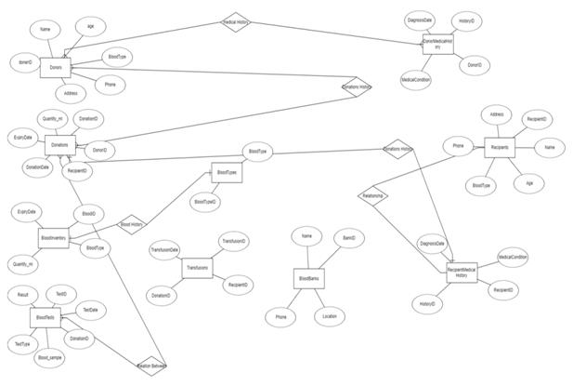
Entity-Relationship Diagram
(ERD Model)

Slide 6
Contribution of each partner
Abdulla arfaq
Used Queries.
M.Sami Malik
Make ER Model
Kantesh Kumar
Make Tables

Slide 7
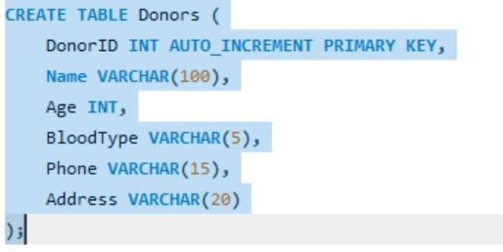
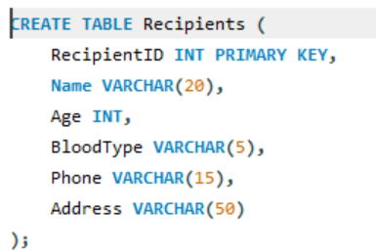
Tables

Slide 8
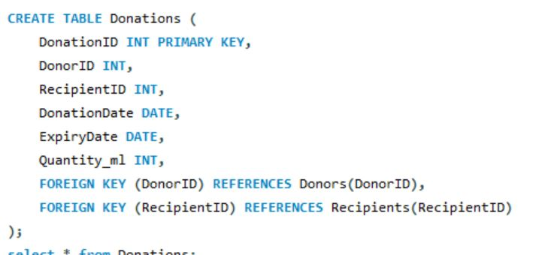
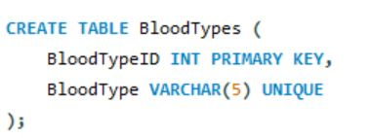
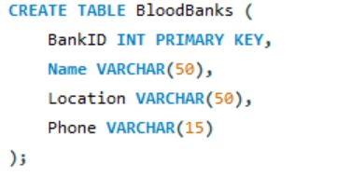

Slide 9
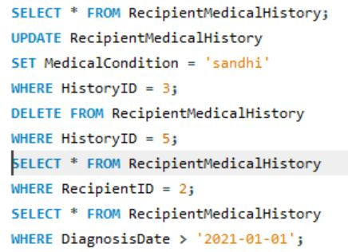
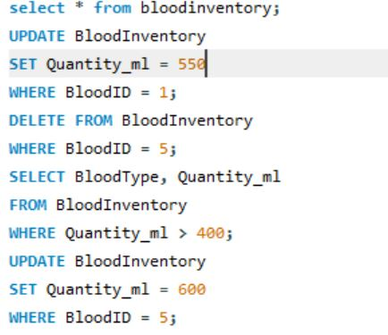
Queries

Slide 10
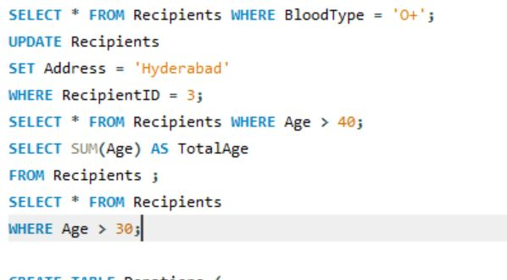
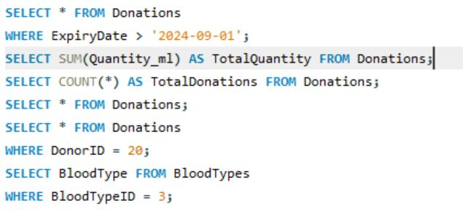

Slide 11
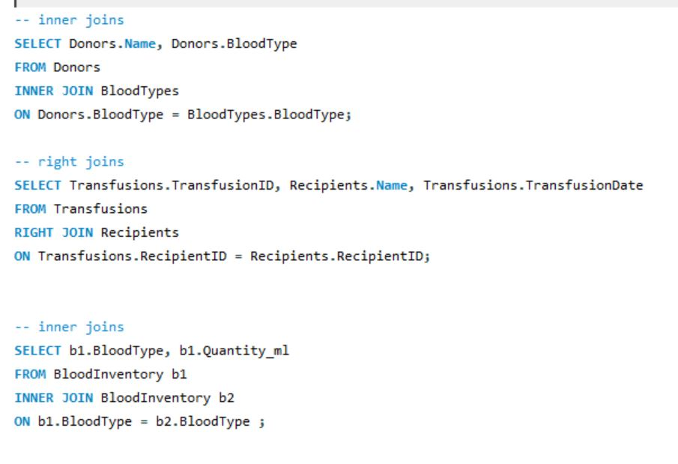
Joins Queries

Slide 12
THANK YOU ☺

